Slide 1




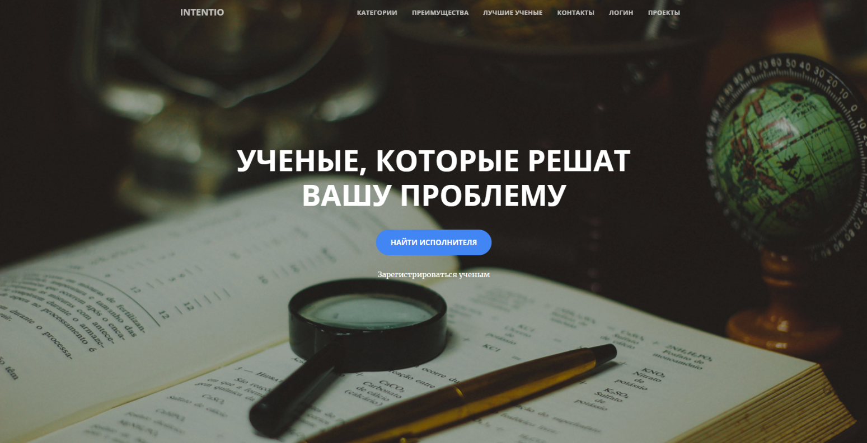
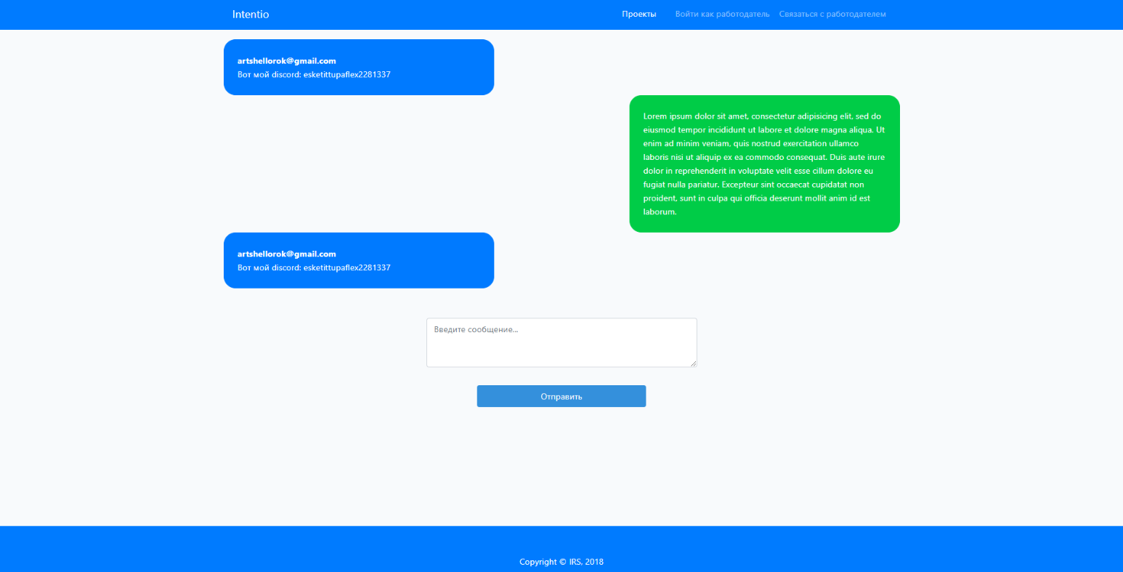
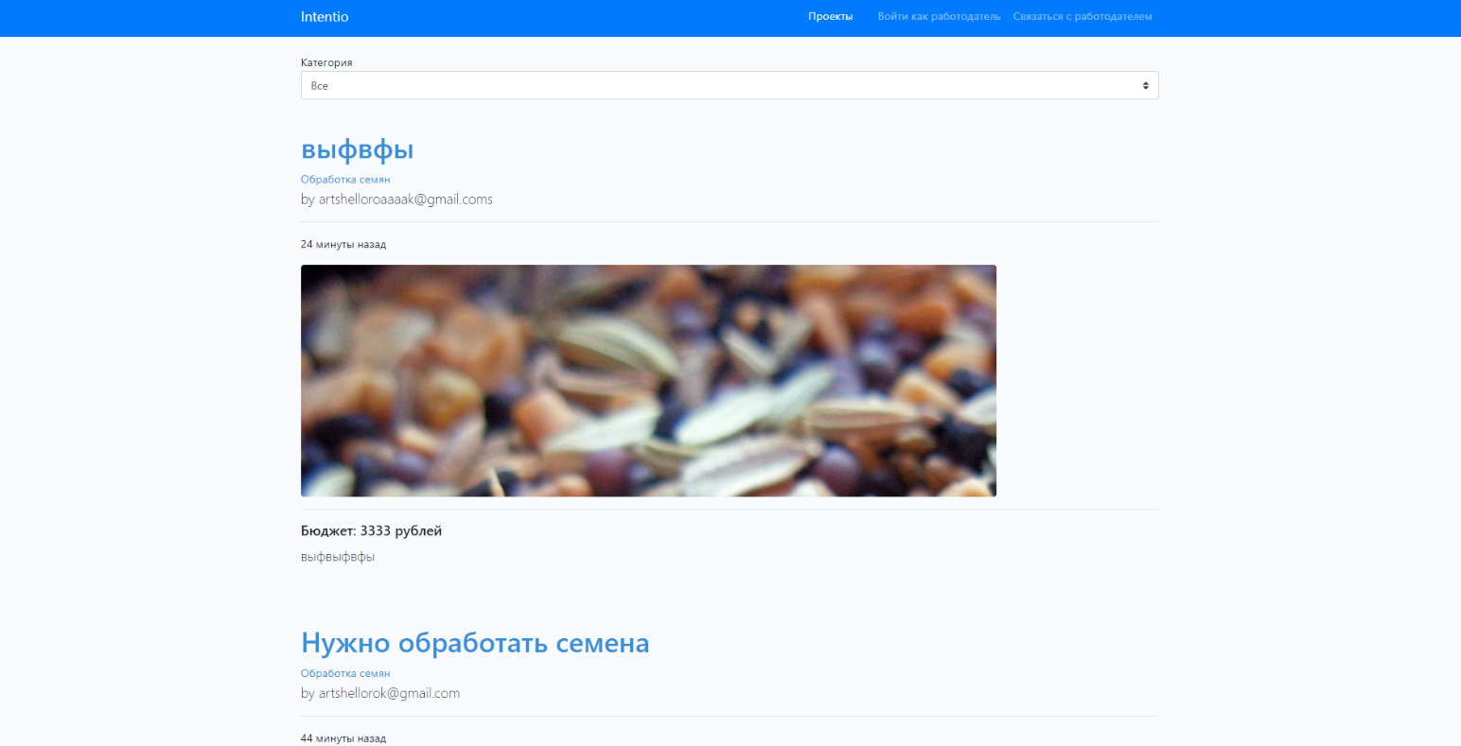





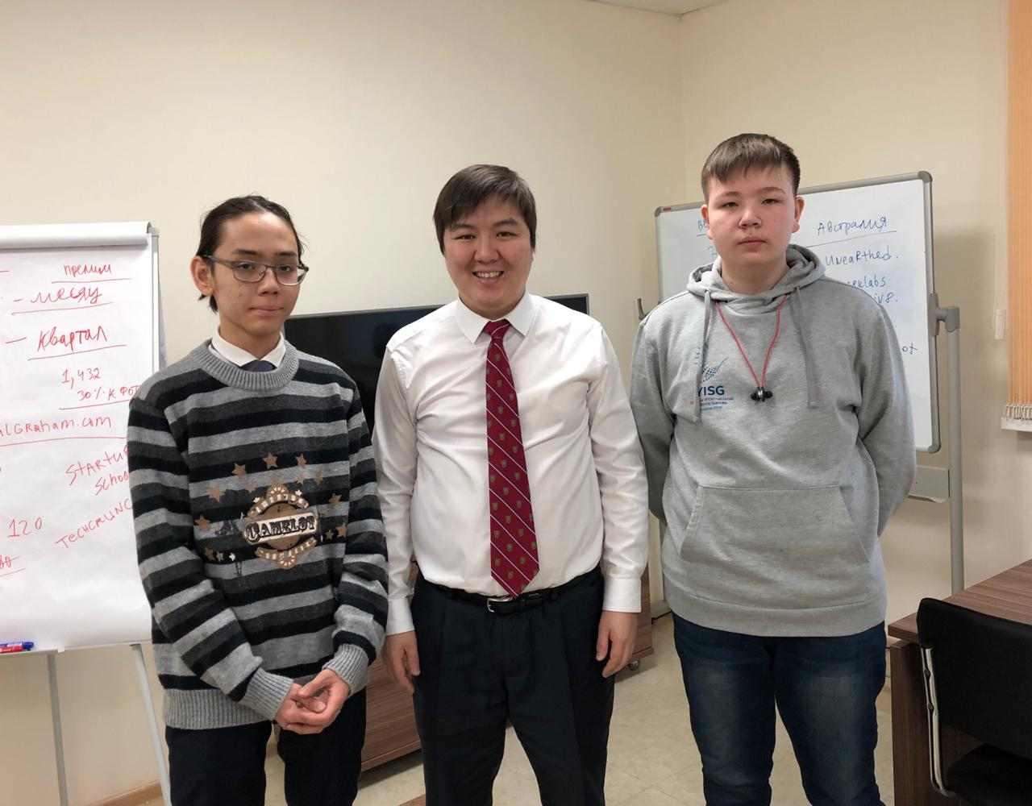
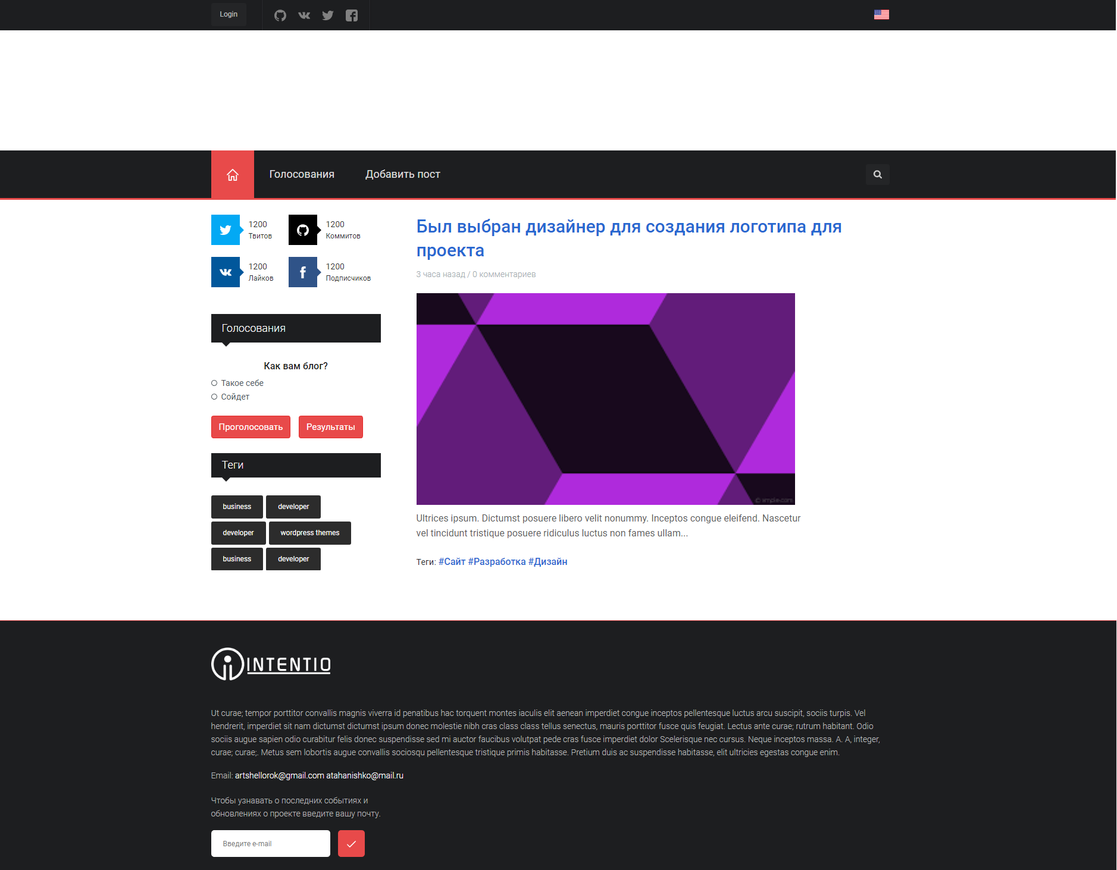
Веб-платформа соединяющая бизнес и науку Web platform that connects business and science
Республиканская научная конференция – конкурса молодых исследователей
имени академика Владимира Петровича Ларионова «Шаг в будущее» V.P.Larionov «Step into the future»
Филиппов Артём, Лазарев Атахан
Filippov Artem, Lazarev Atahan
8 класс 8th grade
Актуальность: Project aims to solve the problem of cooperation between business and science. Currently many existing high-level scientific R&D projects are not applied in practical solutions due to absence of interaction platform with business. Skills and knowledge of experienced scientists is not fully implemented in practice. Moreover, there can be difficulties choosing the vector of career growth for scientists. On the other hand, small and medium-sized business need specialists that can find create or optimize scientific and technical solutions. With help of modern communication means such as IT, it is possible to arrange connection between both science and business without a «middleman». Acceleration of scientific research and development in demanding industry will result in huge economical leap for the country.
Цель: Create a platform (website) for direct cooperation between business and science, where business problems are solved. Entrepreneurs can either publish their problem and select implementer from scientists which replied or select existing solution on the platform and contact the scientist. Scientists can reply to a problem or publish a solution.
Методы: - For creating layout and basic frontend logic were used: jQuery library, Bootstrap framework
- For complex frontend logic we used Vue.js
- Backend part of the site was created using Laravel
- We used linux machine working on CentOS 7 distro with basic apache tls configuration as a web server.
Laravel
Vue.js
Bootstrap
Linux
CentOS 7
Задачи:
Prototype(done):
1) Research solutions of the problem on the internet
2) Analyze the structure of service-client cooperation on growing websites that solve resembling problem
3) Design architecture of the website
4) Create prototype of Intentio
2.Create blog, thus people interested in project can find out about it, leave their feedback, suggestions(current).
3. Test beta version
4. Product release, mass advertising
Afanasiy Savvin helped us contact entrepreneurs and scientists interested in project
Blog main page
Результаты: After the research, we have come to conclusion that there are no similar projects or platforms, which solve problem of cooperation between business and science. After analysis, we concluded there are many IT freelance platforms. We designed the architecture of Intentio and created a prototype with basic fundamental features. These are:
Authentication (Login and registration for both sides – business and science)
Entrepreneurs can publish problems and select implementer.
Scientists can reply to problems
Scientists can contact Entrepreneurs using chat on the website
Thus, We created a prototype of unique beneficial solution without a «middleman» for solving business scientific problems, which will accelerate scientific research and development.
МОБУ “Физико-технический лицей им. В.П. Ларионова, г. Якутск
MEBO “Physical-technical lyceum V.P.Larionov”, Yakutsk

